Slide 1
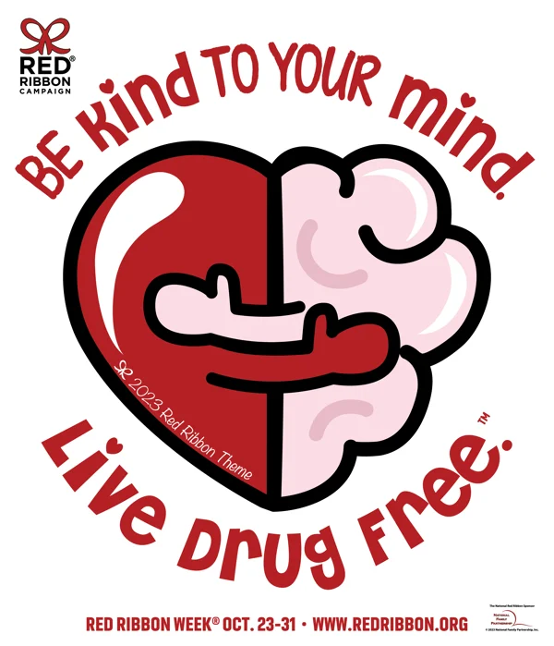
THE 2023 THEME The 2023 Red Ribbon Campaign Theme, "Be Kind to Your Mind. Live Drug Free.™" This year’s theme is a reminder that everyday Americans across the country make significant daily contributions to their communities by being the best they can be because they live Drug-Free! Theme, "Be Kind to Your Mind. Live Drug Free.™" This year’s theme is a reminder that everyday Americans across the country make significant daily contributions to their communities by being the best they can be because they live Drug-Free!

Slide 2
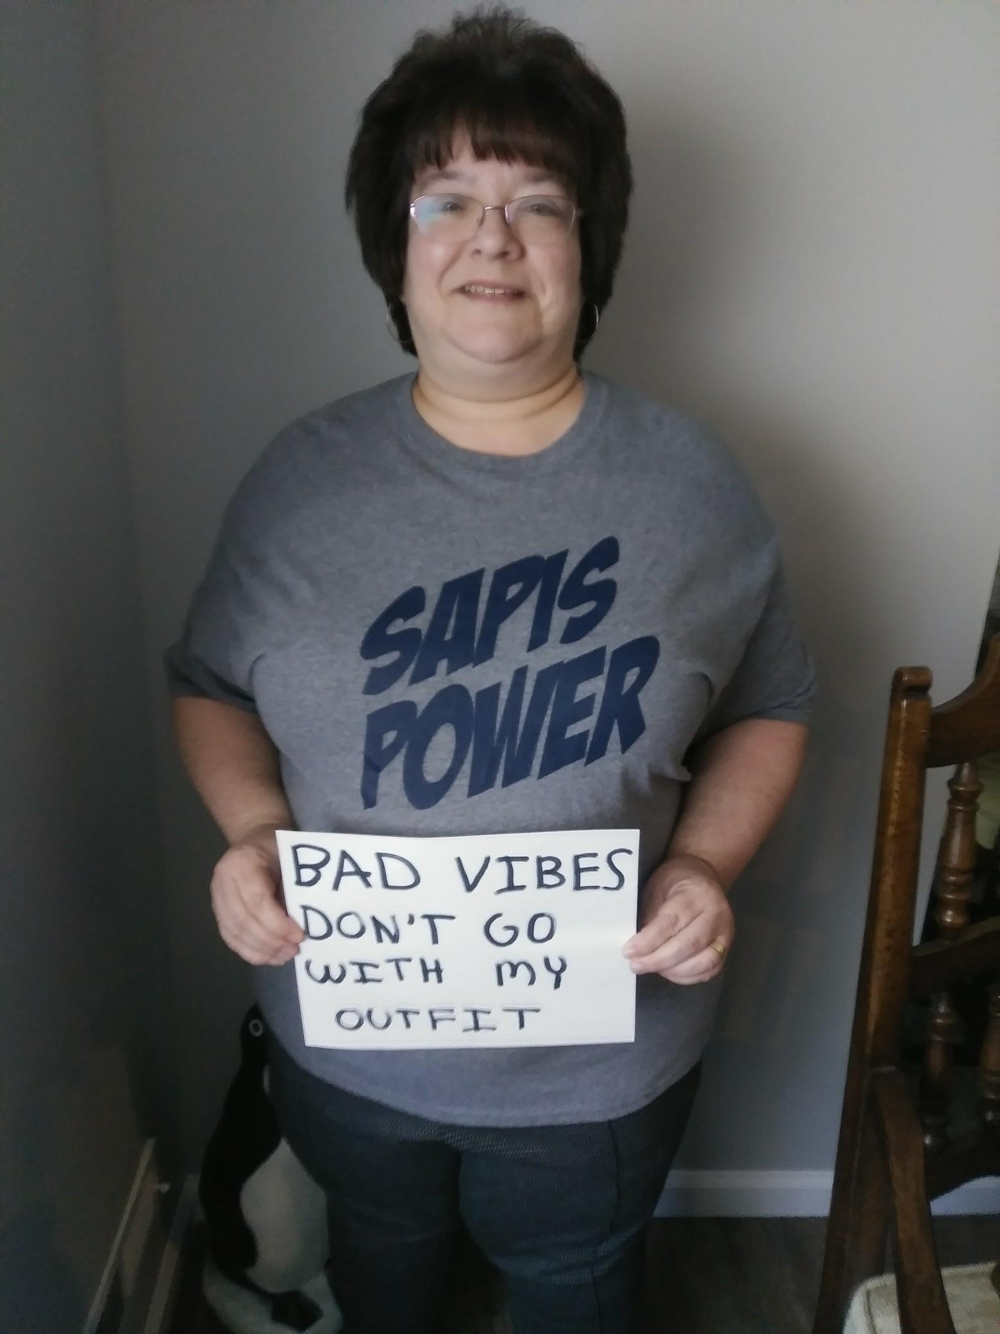
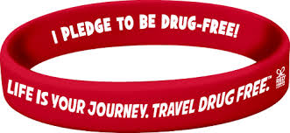
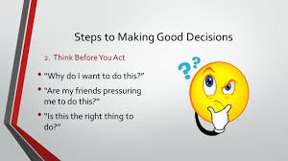
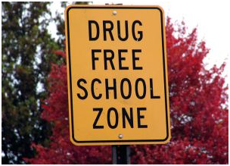
Mrs. Maietta Room 355
SAPIS
Substance Abuse Prevention Intervention Specialist

Slide 3
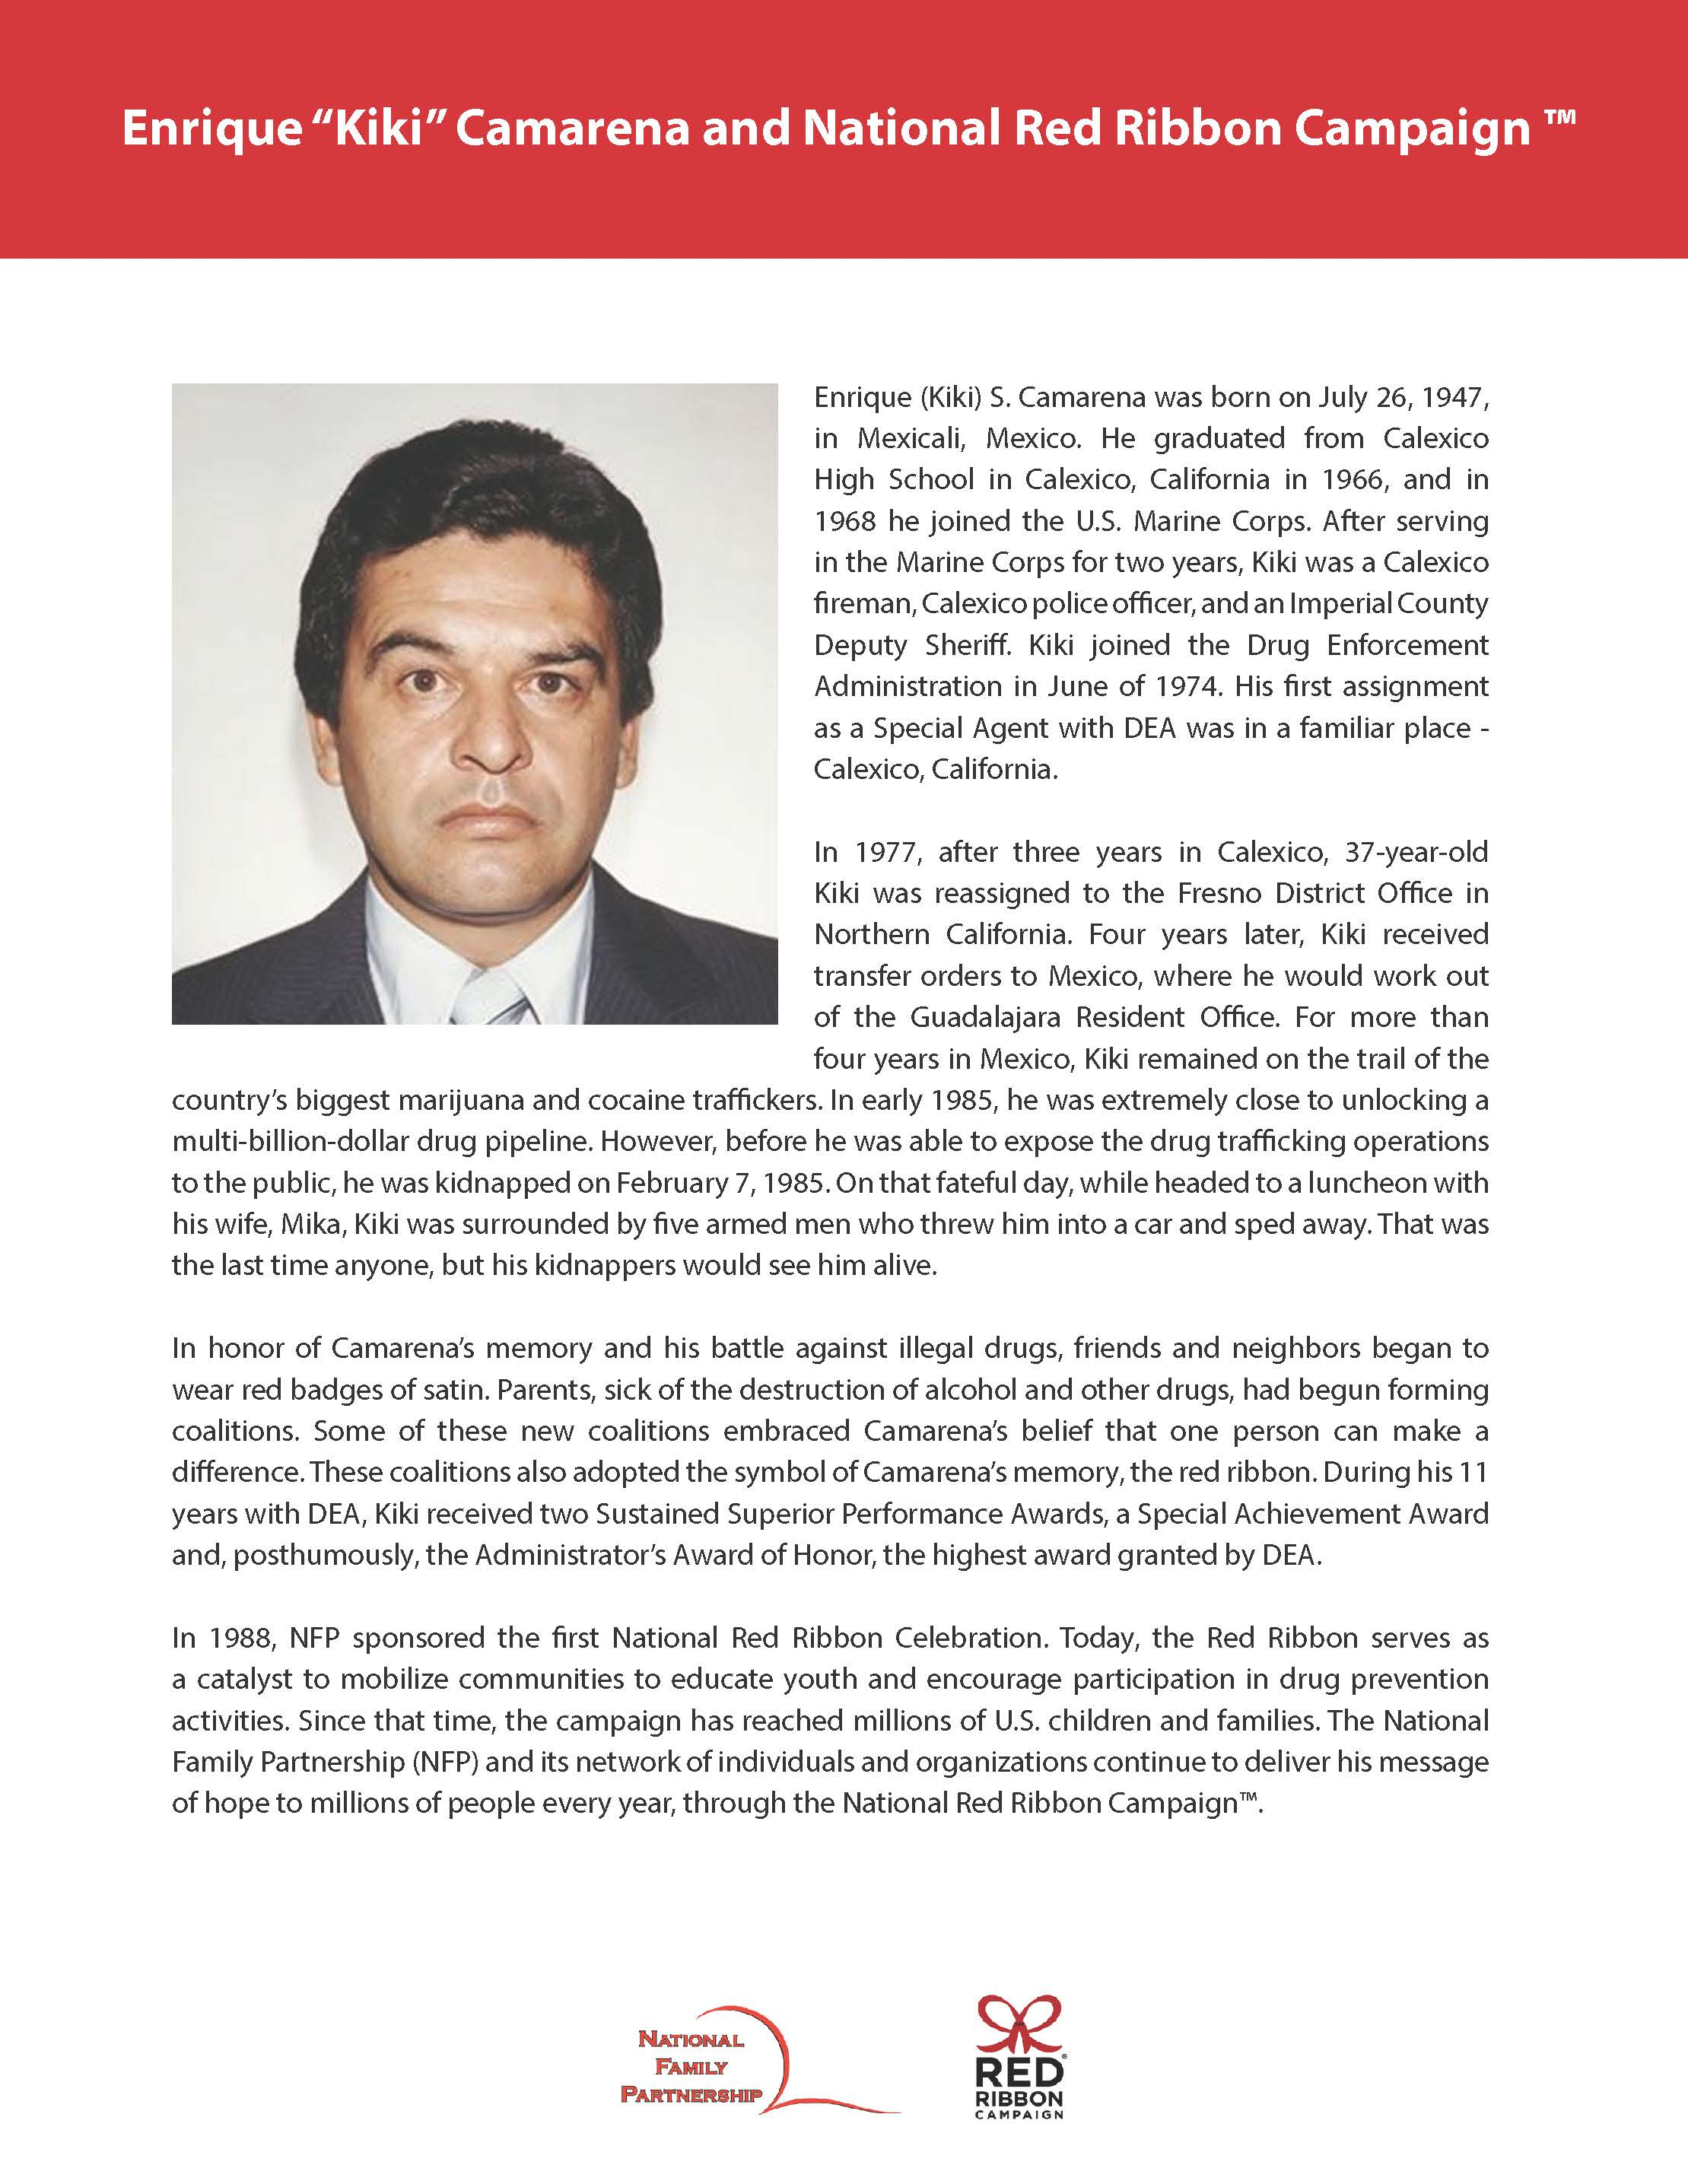

Slide 5
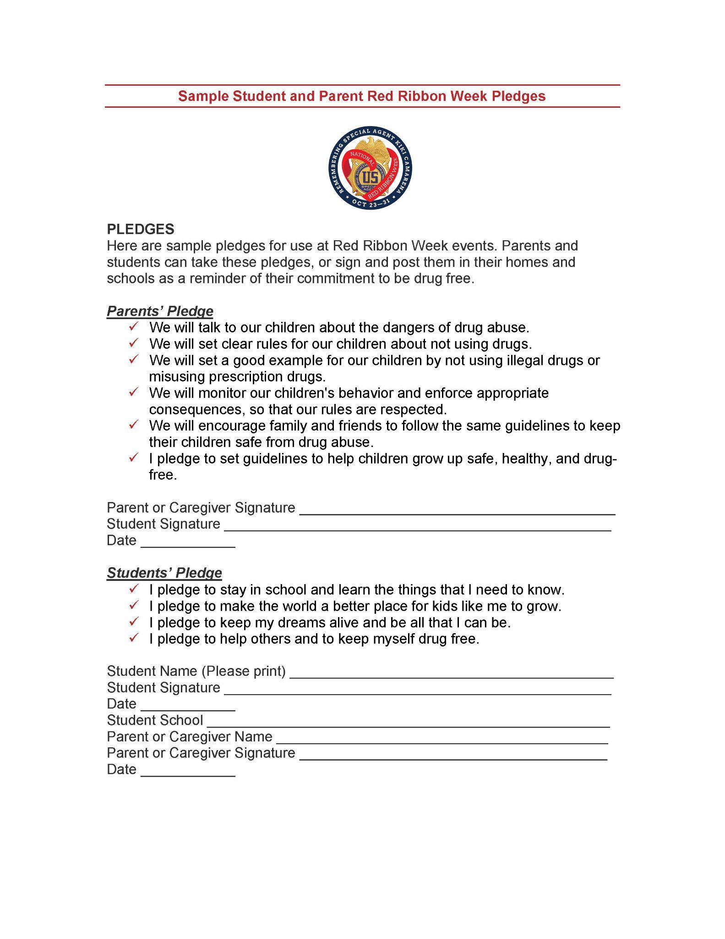
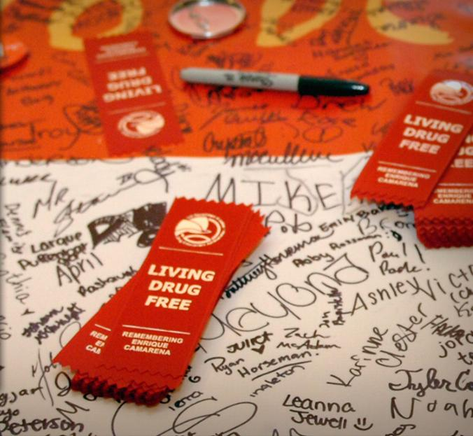
Sign the Pledge with your child…..

Slide 6
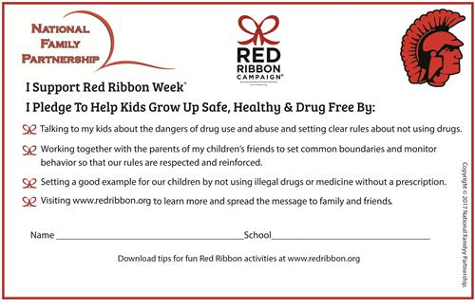

Slide 7
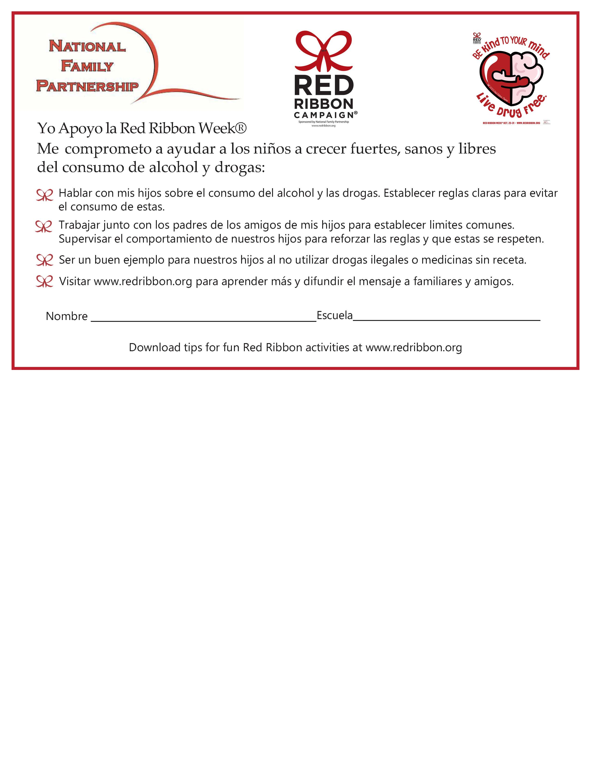

Slide 8
As a parent, you are the biggest influence in your child’s life and having open, honest conversations is one of the most powerful ways to connect with your kids and help them develop into healthy adults. When addressing some more challenging topics – like nicotine, alcohol or drugs – it’s not about having a one-time “drug talk,” but rather tackling the subject through more frequent, organic conversations that evolve as your child gets older. Some things to keep in mind:
Keep lines of communication open and make sure you come from a place of love and compassion – even when you’re having tough conversations.
Balance any consequences with positive encouragement.
Frequent touch points and teachable moments come up all the time — use these as natural opportunities to discuss substance use.

Slide 9
Preteen (9-12 years old)
Preteens who are trying to figure out their place in the world tend to give their friends’ opinions a great deal of power. At the same time, they’re also beginning to question their parents’ views and rules. This shift is natural, healthy and part of a normal process of maturity and identity development. The following are some age-appropriate scenarios to help your preteen understand how to stay healthy and avoid risks related to substance use.

Slide 10
Prevention tips for preteens: https://drugfree.org/article/prevention-tips-for-every-age/
Make sure your child knows your rules — and that you’ll enforce the consequences if rules are broken. Kids are less likely to use nicotine, alcohol and other substances if their parents have established a pattern of setting clear rules and consequences.
Feelings of insecurity, doubt and pressure may creep in during puberty. Offset those feelings with a lot of positive comments about your child’s individuality and strengths. Focus on their effort, creativity and kindness rather than specific outcomes such as good grades or winning a game.
Get to know your child’s friends — and their friends’ parents. Check in by phone or a visit once in a while to make sure they are on the same page with regard to supervision and prohibiting substance use, particularly when their home is to be used for a party or sleepover.
Help children separate reality from fantasy. Watch shows or movies with them and ask lots of questions to reinforce the distinction between the two. Remember to include advertising in your discussions, as those messages are especially powerful. https://drugfree.org/article/prevention-tips-for-every-age/

Slide 11
October 23 marks the beginning of Red Ribbon Week (link to blog). Celebrated annually from October 23-31, Red Ribbon Week is dedicated to raising awareness for substance-use prevention programs and efforts in schools. Around the country, students are learning about the importance of staying substance-free and saying “NO” to risky behaviors like underage drinking and underage cannabis use.
Since this is a topic that many kids will be discussing at school, we encourage you to find ways to keep these conversations going.
Check out these five conversations to have with your kids to extend their Red Ribbon Week lessons at home.
Review your family values. Establishing values helps kids keep their priorities top-of-mind. Try simple lessons that are easy to comprehend such as “We follow the rules, and the rules say the legal drinking age is 21.” “We respect our brains and bodies, so we know it’s not safe for kids to drink alcohol underage.”
Talk about peer pressure. Making good decisions can be challenging, but peer pressure is part of life. Being ready for it can make all the difference! Talk about self-confidence and knowing the difference between right and wrong. Finish the conversation by asking your kids about positive peer pressure! What is something great or brave that someone else inspired them to do because of their actions? Sometimes focusing on the good news can help kids open up and about ALL the news.
Discuss personal goals. Take a look at what your kids are doing now and ask them where they want to be in 5, 10, or even 50 years! Let them come up with some roadblocks that might get in the way of them meeting their goals. Underage drinking or substance use can put the brakes on short- and long-term goals, so encourage them to keep their eyes on the future!
Create and practice refusal strategies. Saying NO to underage drinking or other risky behaviors is so much easier after practicing! Talk with your kids about the various ways they can get out of a sticky situation. You can even use our 10 Ways to Say NO infographic (LINK) to help get the conversation started.
Chat about your favorite ice cream flavor. That’s right! Not every conversation is serious. Not every conversation is about alcohol or making healthy choices. Take time to be silly, speak freely, and debate why chocolate chip ice cream is by far the most underrated flavor!
Parents, you are the #1 influence on your kids’ decisions to drink—or not to drink—alcohol. Keep up the great work. Your kids hear you, and they are listening, even when you think they aren’t. They are also watching and learning from your successes, attempts, and even your missteps. So, continue to model healthy ways to cope with stress, overcome obstacles, and treat others with dignity and respect.
Thank you for bringing Red Ribbon Week home to empower your kids to make the decision to remain substance-free.

Slide 12
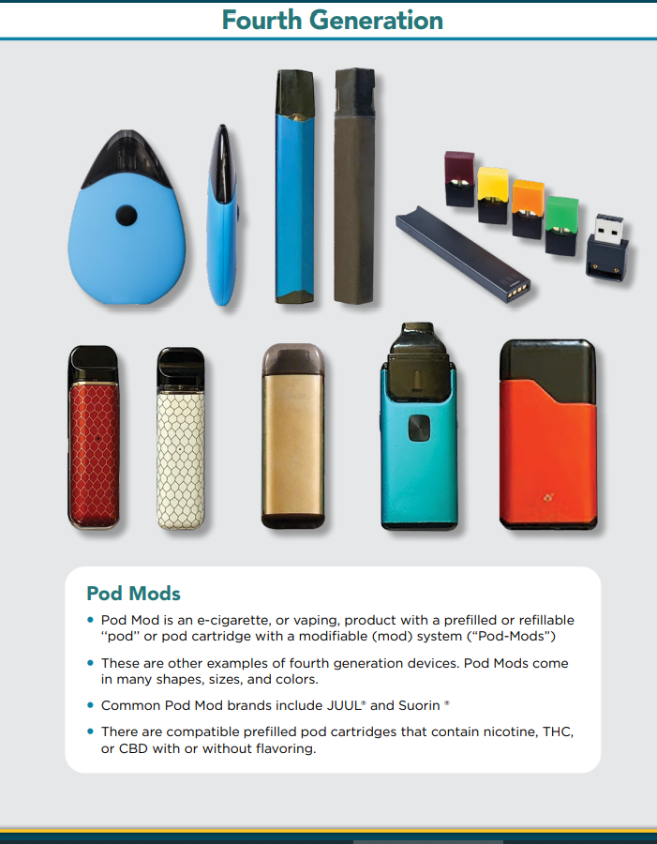
Have You Seen This At Home?
HRM VIDEO

Slide 13
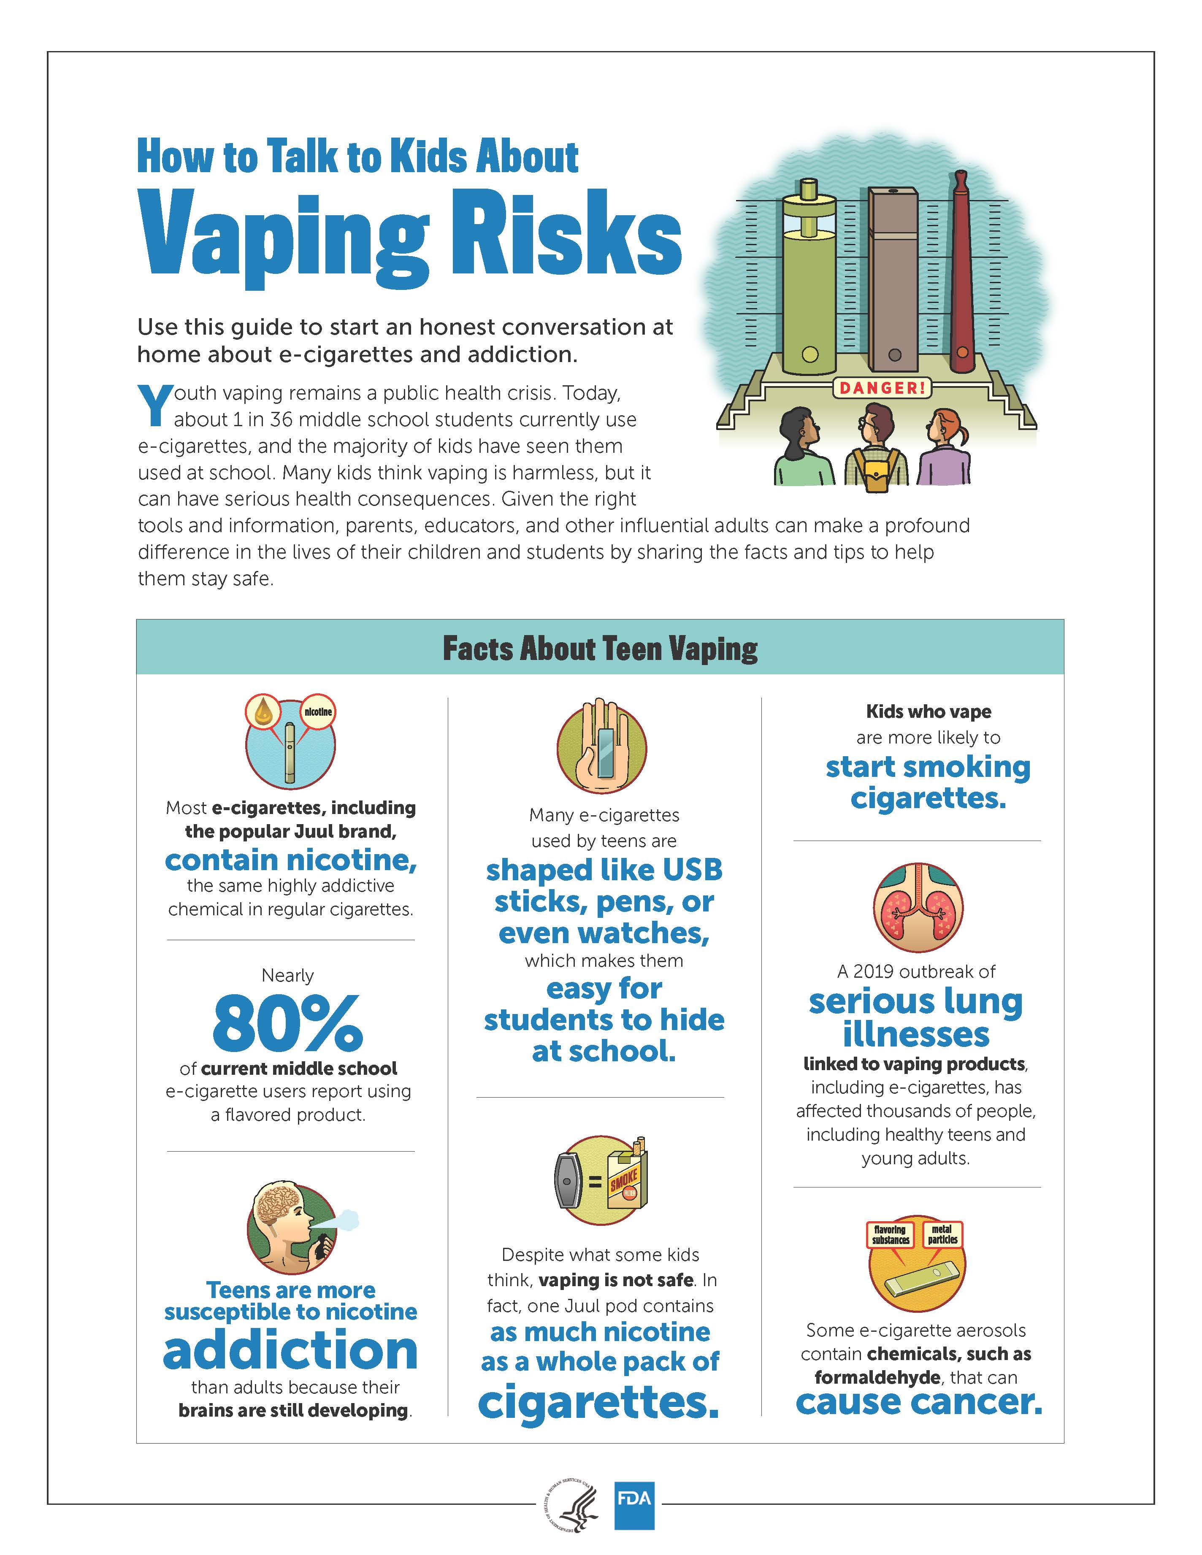

Slide 14
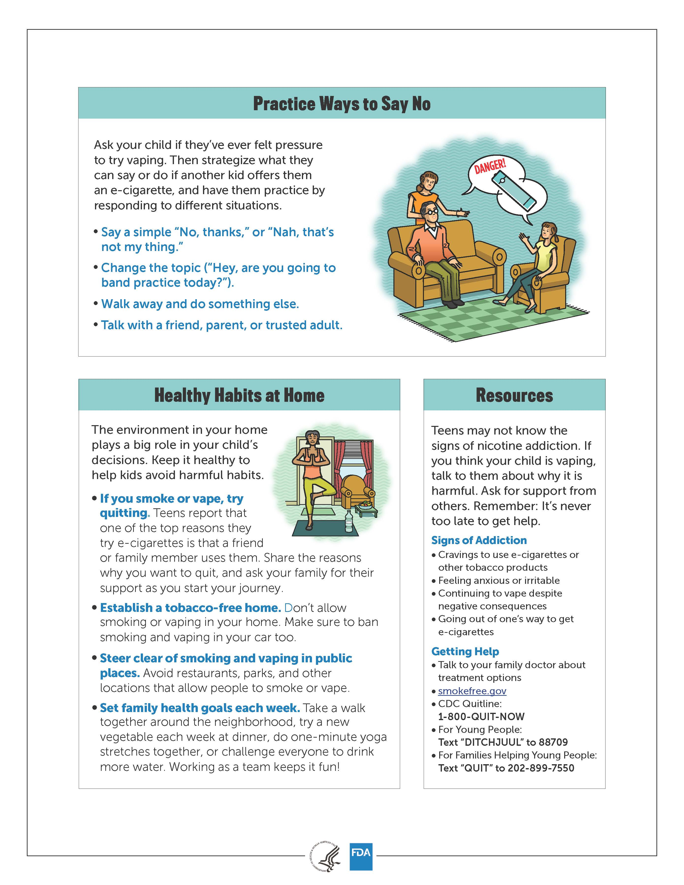

Slide 15
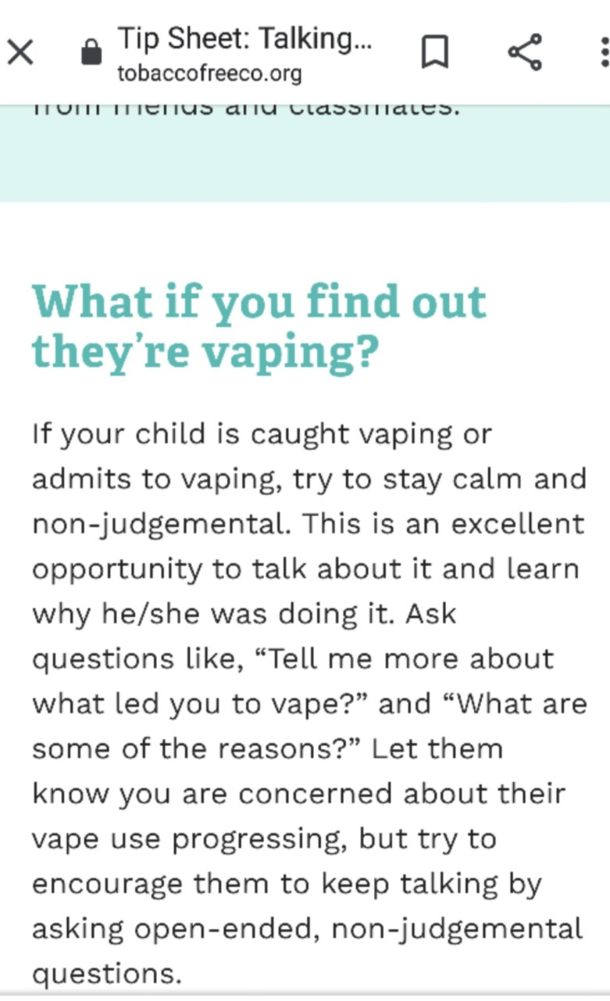

Slide 16
Is marijuana the same thing as cannabis?
People often use the words “cannabis” and “marijuana” interchangeably, but they don’t mean exactly the same thing.
The word “cannabis” refers to all products derived from the plant Cannabis sativa.
The cannabis plant contains about 540 chemical substances.
The word “marijuana” refers to parts of or products from the plant Cannabis sativa that contain substantial amounts of tetrahydrocannabinol (THC). THC is the substance that’s primarily responsible for the effects of marijuana on a person’s mental state.

Slide 17
QUIZ: VAPING & MARIJUANA
Think you know everything you need to know about vaping marijuana?
https://www.justthinktwice.gov/quiz/quiz-vaping-marijuana

Slide 18
It’s important for parents and caregivers to note that marijuana may impact the brains of young people differently than it impacts the brains of fully mature adults. Long-lasting or permanent effects on the developing adolescent brain due to marijuana use may include:
Difficulty with critical thinking skills like attention, problem solving and memory
Impaired reaction time and coordination, especially as it relates to driving
Decline in school performance
Increased risk of mental health issues including depression or anxiety and, in some cases, psychosis where there is a family history of it.

Slide 19
WHAT ARE THE NEGATIVE EFFECTS OF MARIJUANA EDIBLES?
Psychotic episodes
Hallucinations
Paranoia
Panic attacks
Impaired motor ability
For youths, the risks outlined include panic attacks, psychosis, and hyperemesis syndrome — a serious condition that results in uncontrollable vomiting.
There are also potential long-term effects from cannabis consumption beginning at a young age, including “impaired brain development and poor mental health.”
Older adults, the other at-risk group outlined in the report, may experience increased cognitive impairment, risk of falls, heart arrhythmia, and various drug interactions.
According to Loh, these two groups are at higher risk because, “[They] have different metabolic rates and pharmacokinetics than other groups and hence respond differently… For seniors, many may have other conditions that might place them at risk of overconsumption and other indirectly related health issues.”
Rais Vohra, the Medical Director for California Poison Control System Fresno Madera District, told Healthline that his experience in dealing with emergencies associated with cannabis edibles are consistent with findings in the report.

Slide 20
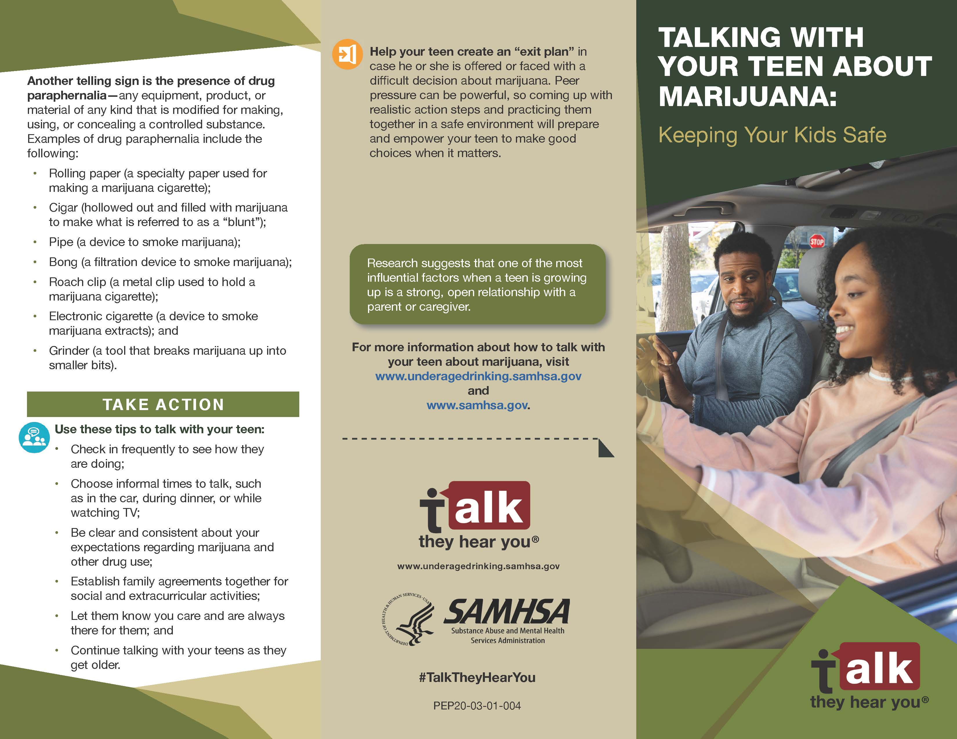

Slide 21
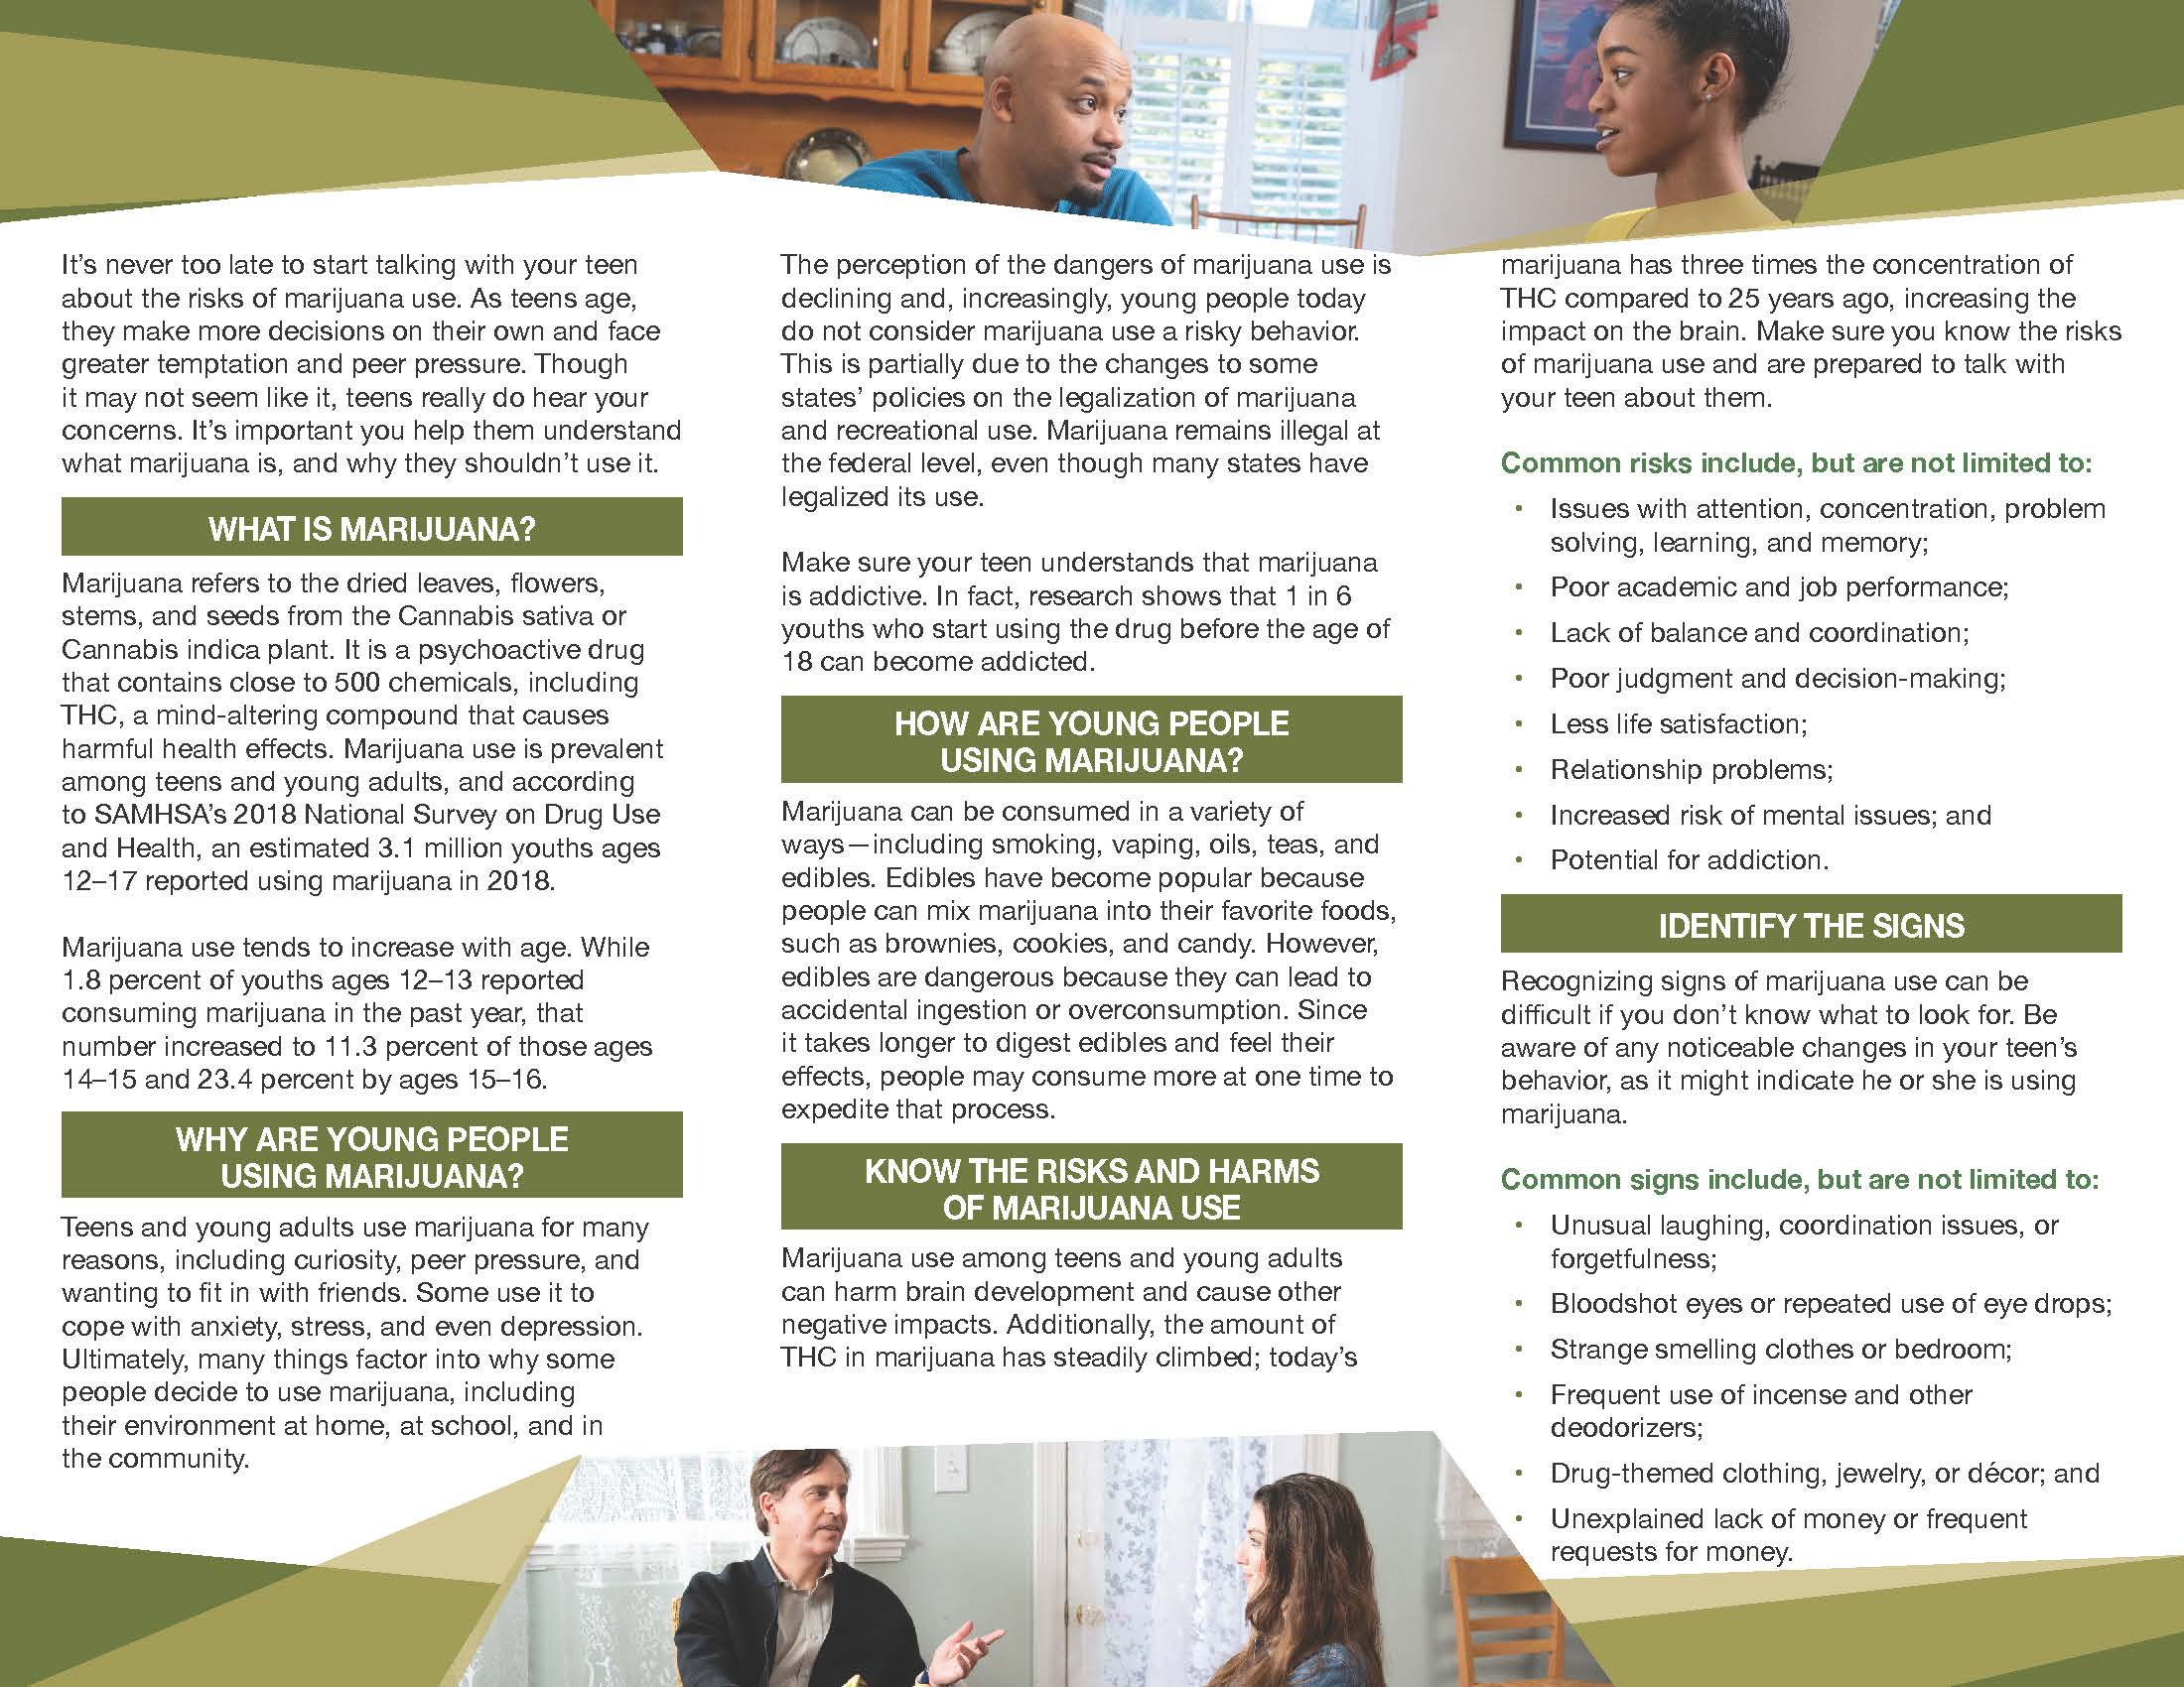

Slide 22
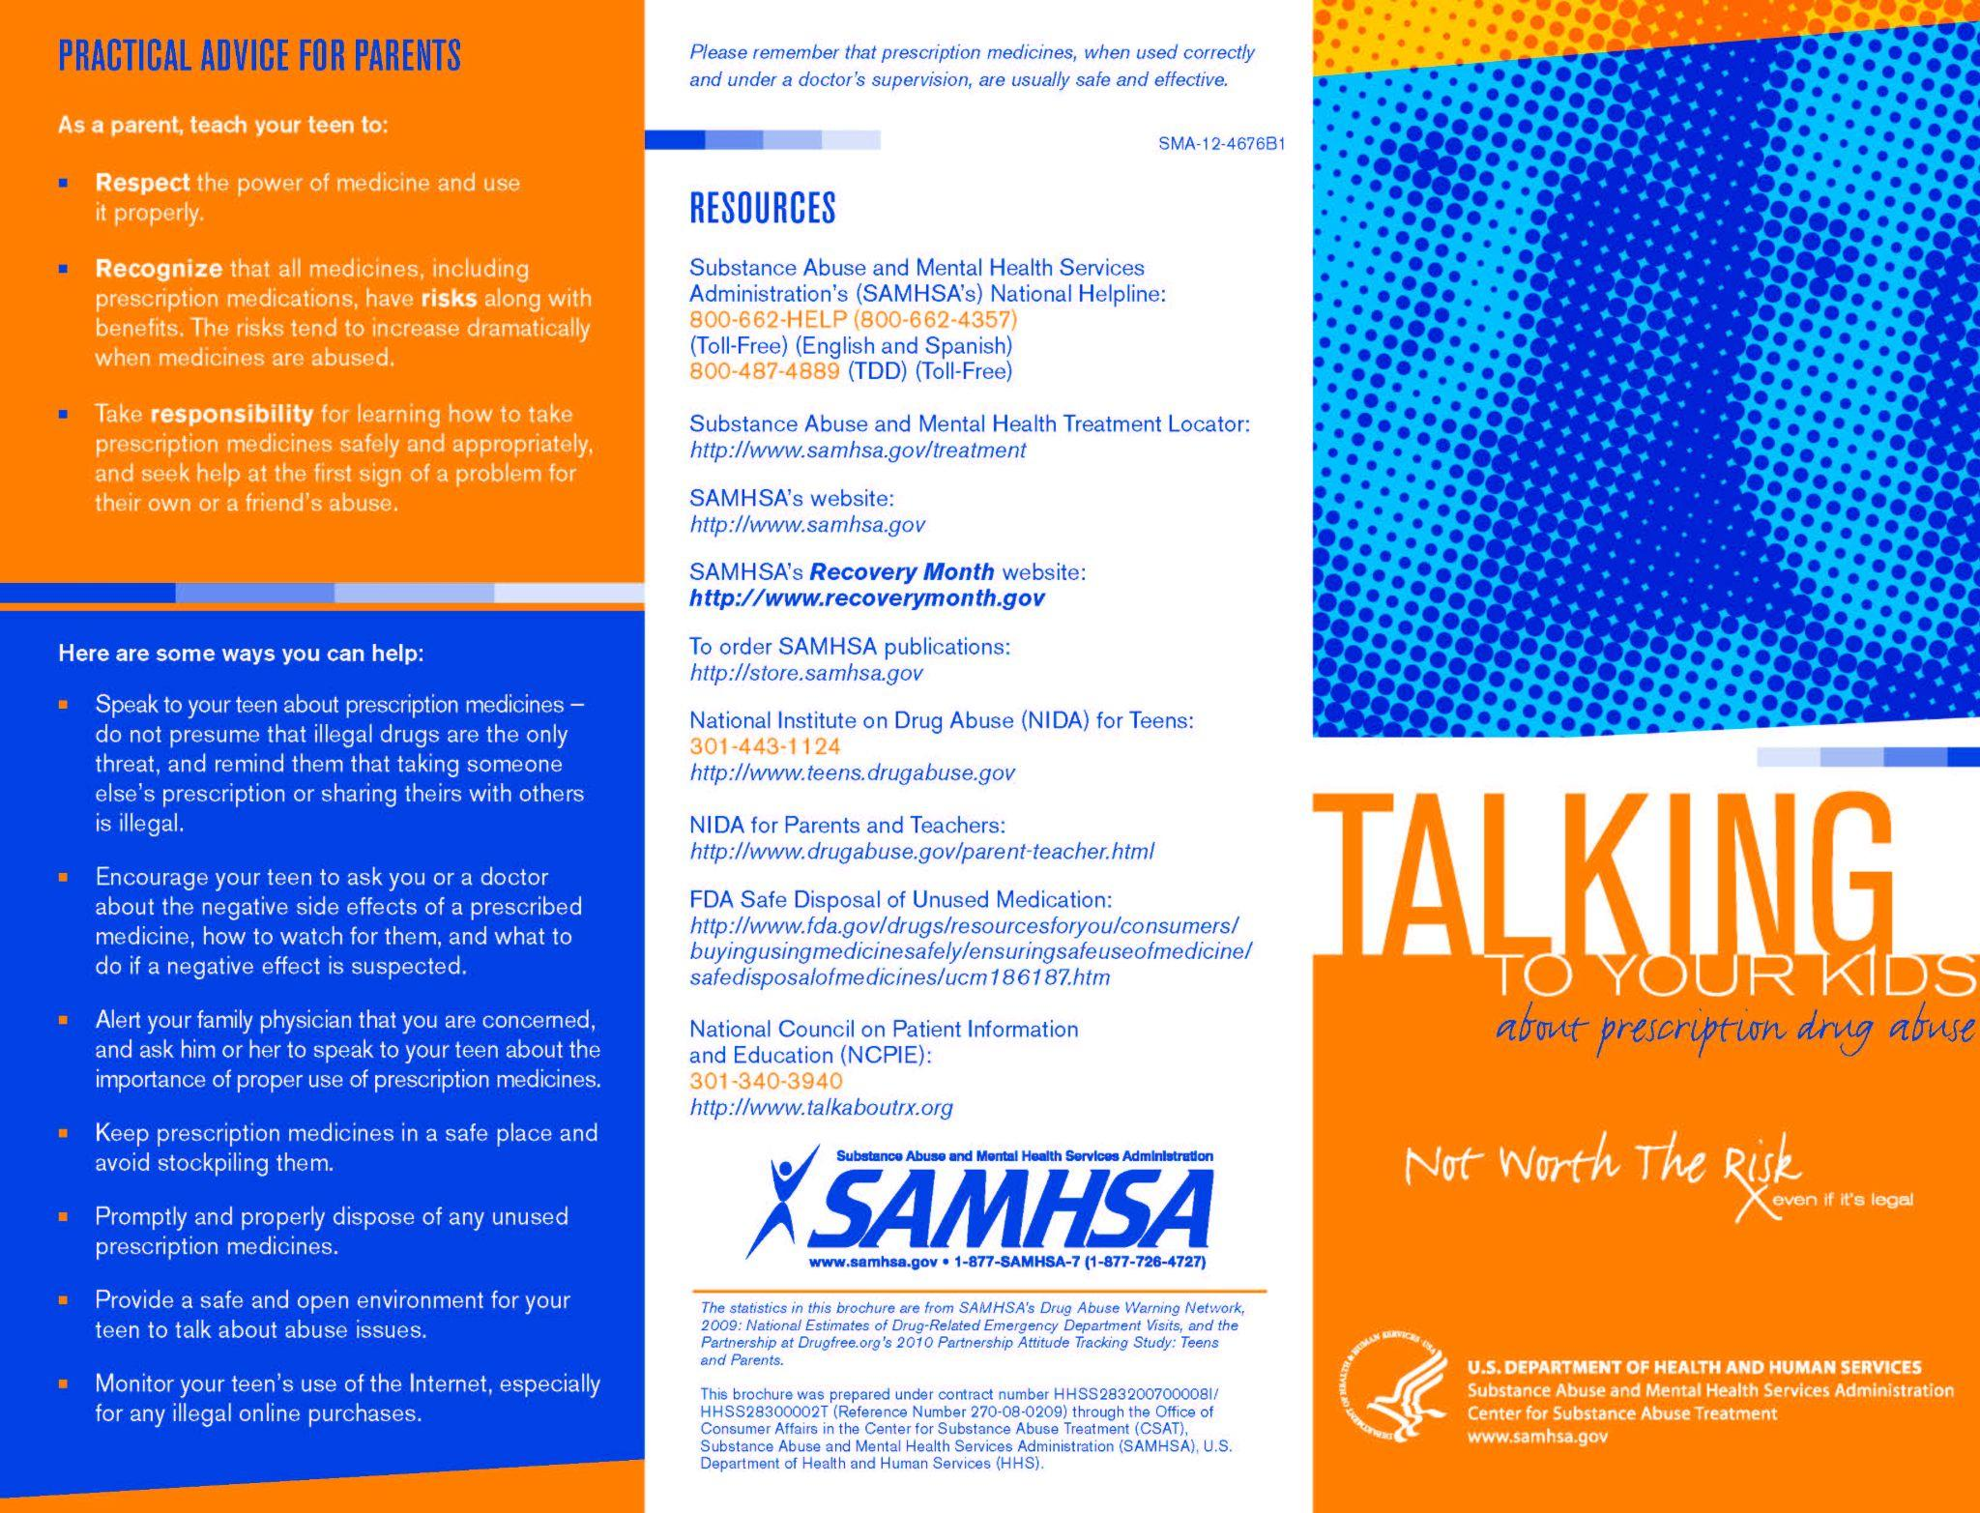

Slide 23
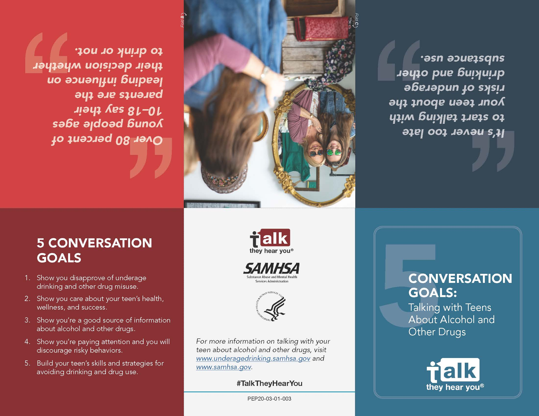

Slide 24
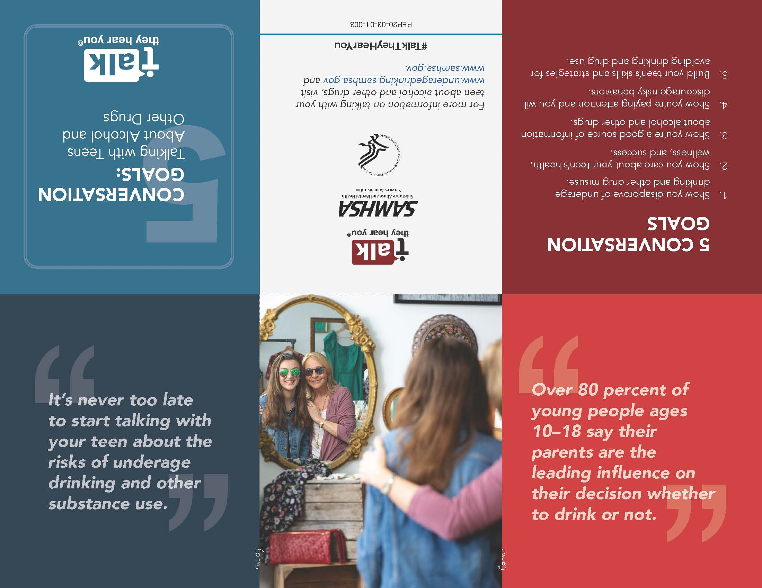

Slide 25
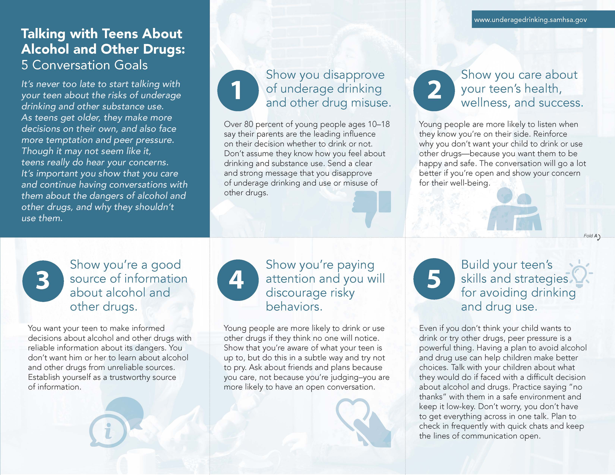

Slide 26
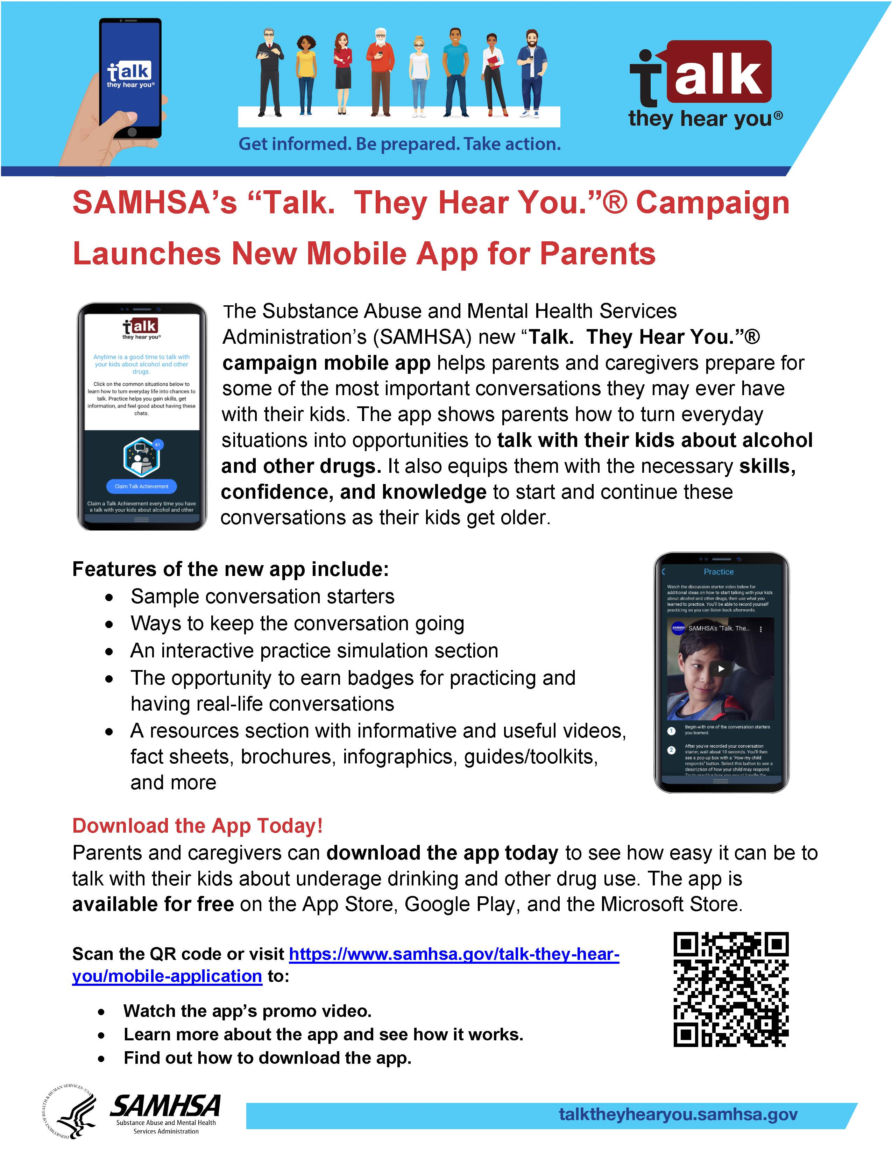

Slide 27
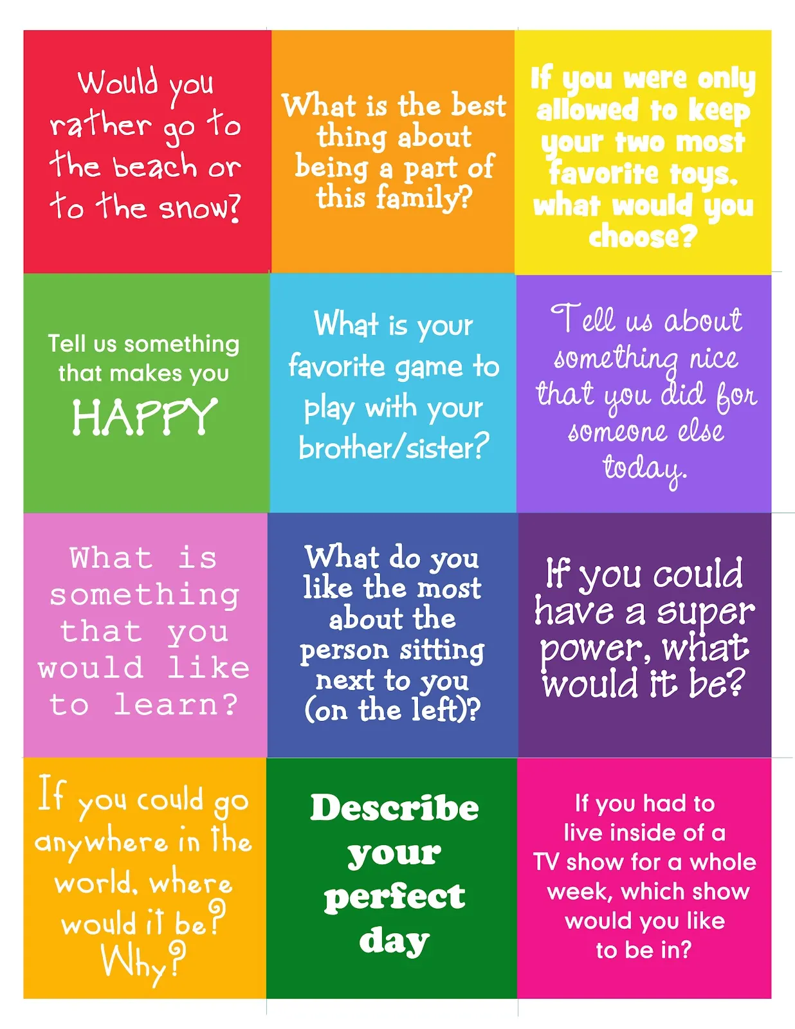

Slide 28
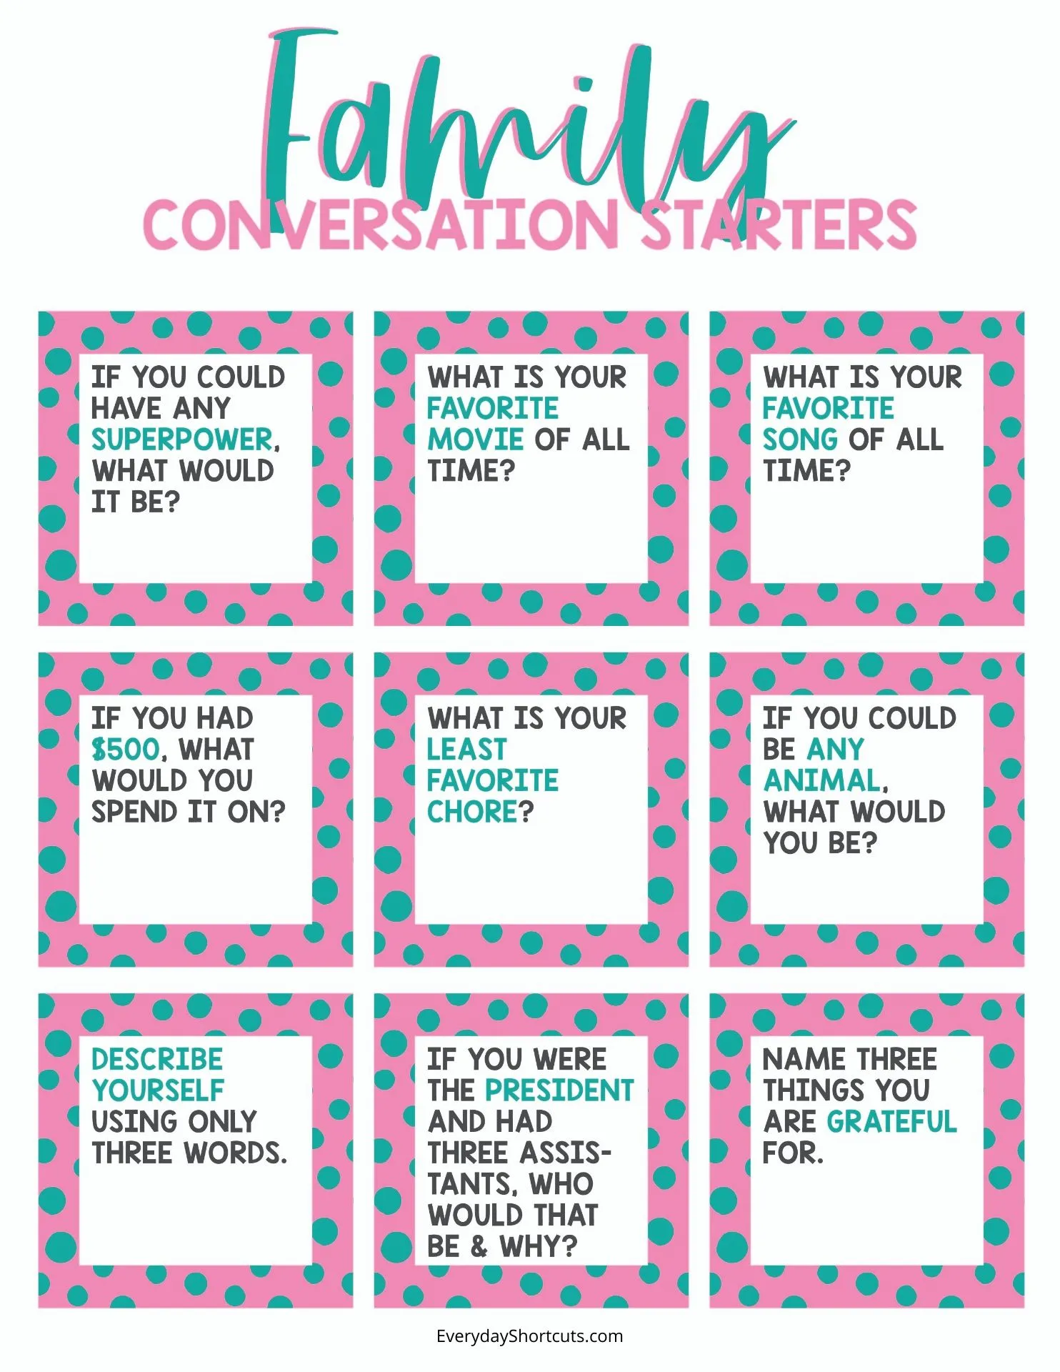

Slide 29
